Slide 1

C# Training Basic
Aravind Kumar P

Slide 2
.NET Introduction
.NET is a Framework developed by Microsoft 2002 version 1.0 and the current version is 4.8
Microsoft Visual Studio is an Integrated Development Environment
C# is a general-purpose multi-paradigm programming language was developed by Microsoft within its .NET initiative and later approved as a standard by ECMA-334

Slide 3
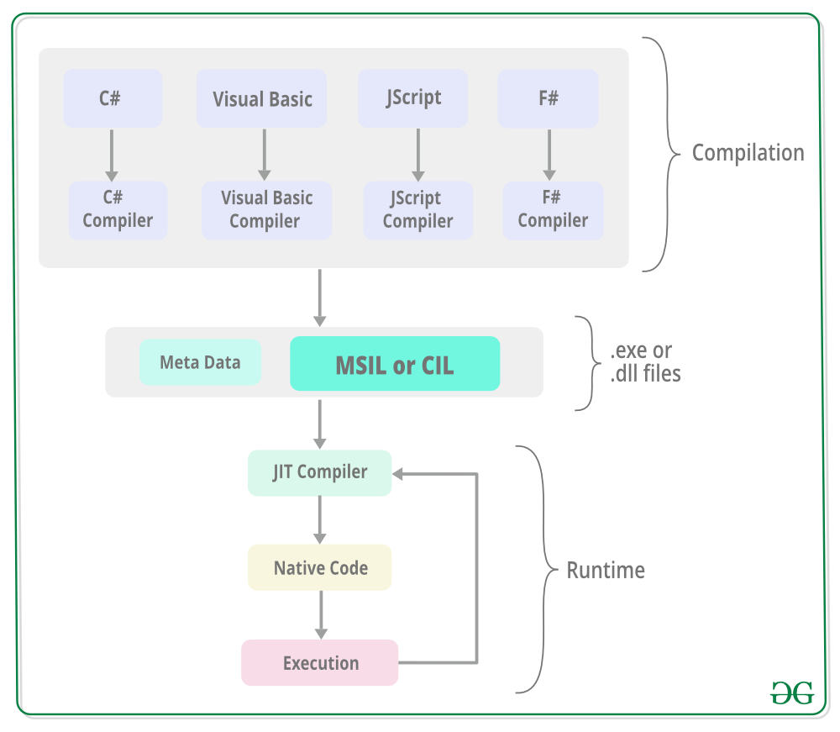
Architecture
Common Language Infrastructure
Language specific compilers compiles the source code into MSIL(Microsoft Intermediate Language)/CIL (Common Intermediate Language) / LI (Intermediate Language) along with Metadata
CLR provides the services and runtime environment to the MSIL code
JIT (Just-in-time) complier (is part of CLR) which converts the MSIL code native code which is further executed by the CPU

Slide 4
Common Language Runtime
CLR

Slide 5
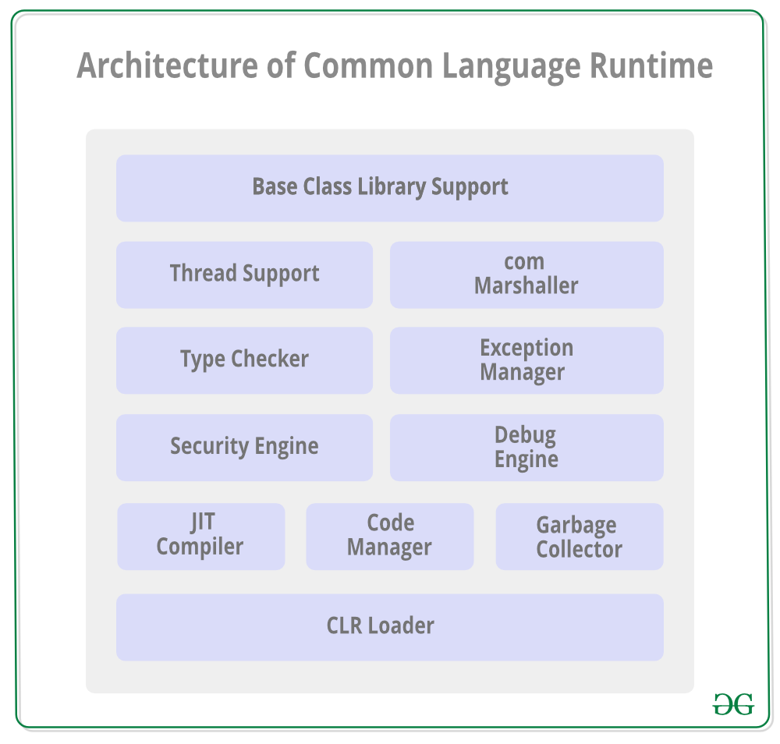
Architecture of CLR
Common Language Runtime is the programming (Virtual Machine component) that manages the execution of programs written in any language that uses the .NET Framework, for example C#, VB.Net, F# and so on.
Common Type System (CTS)
CTS is responsible for the understanding all the data type system of .NET programming languages and converting them into CLR understandable format which will be a common format
Common Language Specification (CLS):
CLS is a subset of the CTS, provides interoperability between different language specific code.

Slide 6
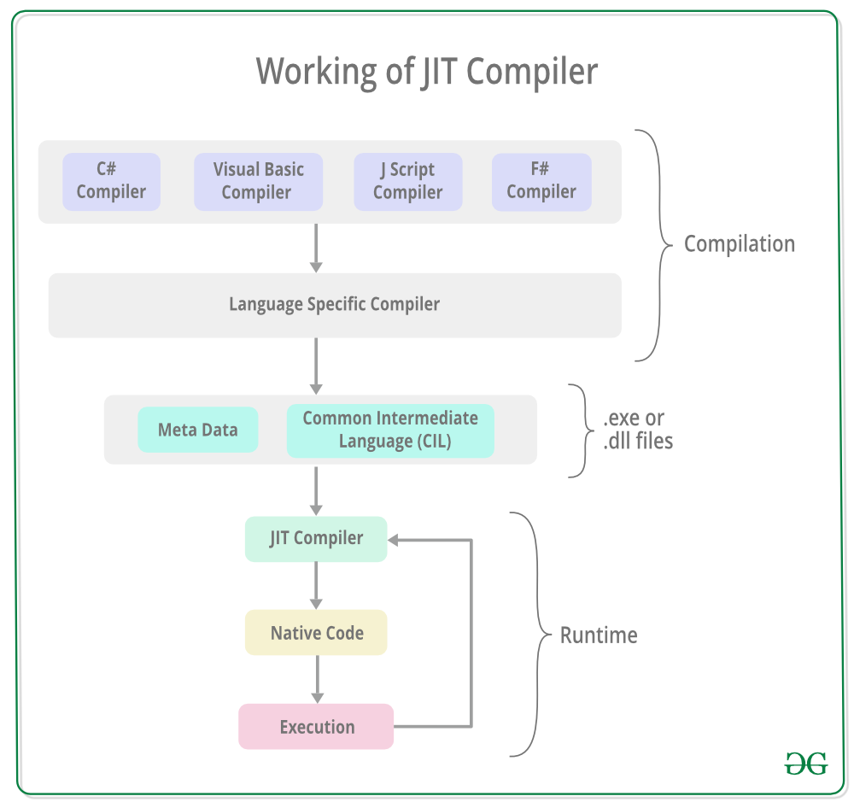
Application Execution Process
The source code converts in to CIL and metadata
A common Language Infrastructure (CLI) assembly is created by assembling MSIL. This assembly could be process assembly (EXE) or library assembly (DLL)
JIT complies MSIL to machine specific code and executed by the processor of the computer
DEMO

Slide 7
Demo
Code compilation using C#: csc program.cs -target:exe
Disassembling the library or exe : ildasm program.exe /out="program.il"
Assembling the library or exe : ilasm program.il /X64
Sample Program
using System;
public class Demo
{
public static void Main()
{
Console.WriteLine("Hello World");
Console.ReadKey();
}
}

Slide 8
Overview of C#
Structure of C# Program.
Editors for writing C# Program.
Compiling and Debugging a Program.
CLR in terms.
Data Types in C#. - https://www.tutorialsteacher.com/csharp/csharp-data-types
C# Programming Guidelines.
Naming Convention standards.
Basic Input/output operators
Program Flow
Structure Programming in C#.

Slide 9
Data Types and Operators
Value Types: Bool, byte, char, decimal, double, enum, float, int, long, sbyte, short, struct, uint, ulong, ushort
Reference Types: String, Array, Class Delegate
Arithmetic Operators, Relational Operators
Assignment Operators, Conditional Operators
Looping and Branching statements.
Class, Fields, Methods, Properties
Access Specifiers https://www.c-sharpcorner.com/UploadFile/84c85b/oop-series-sharp2-understanding-access-specifier-with-C-Sharp/
Print(names);

Slide 10
Array Collection Generics
Array
Collections
Generic Collections
Generic Methods, Generic Classes
https://docs.microsoft.com/en-us/dotnet/csharp/programming-guide/generics/constraints-on-type-parameters

Slide 11
Generic Collection
Generic Collections | Description
List<T> | Generic List<T> contains elements of specified type. It grows automatically as you add elements in it.
Dictionary<TKey,TValue> | Dictionary<TKey,TValue> contains key-value pairs.
SortedList<TKey,TValue> | SortedList stores key and value pairs. It automatically adds the elements in ascending order of key by default.
Queue<T> | Queue<T> stores the values in FIFO style (First In First Out). It keeps the order in which the values were added. It provides an Enqueue() method to add values and a Dequeue() method to retrieve values from the collection.
Stack<T> | Stack<T> stores the values as LIFO (Last In First Out). It provides a Push() method to add a value and Pop() & Peek() methods to retrieve values.
Hashset<T> | Hashset<T> contains non-duplicate elements. It eliminates duplicate elements.

Slide 12
Data Types
Type | Represents | Range | Default Value
bool | Boolean value | True or False | False
byte | 8-bit unsigned integer | 0 to 255 | 0
char | 16-bit Unicode character | U +0000 to U +ffff | '\0'
decimal | 128-bit precise decimal values with 28-29 significant digits | (-7.9 x 10²⁸ to 7.9 x 10²⁸) / 10⁰ to 28 | 0.0M
double | 64-bit double-precision floating point type | (+/-)5.0 x 10⁻³²⁴ to (+/-)1.7 x 10³⁰⁸ | 0.0D
float | 32-bit single-precision floating point type | -3.4 x 10³⁸ to + 3.4 x 10³⁸ | 0.0F
int | 32-bit signed integer type | -2,147,483,648 to 2,147,483,647 | 0
long | 64-bit signed integer type | -9,223,372,036,854,775,808 to 9,223,372,036,854,775,807 | 0L
sbyte | 8-bit signed integer type | -128 to 127 | 0
short | 16-bit signed integer type | -32,768 to 32,767 | 0
uint | 32-bit unsigned integer type | 0 to 4,294,967,295 | 0
ulong | 64-bit unsigned integer type | 0 to 18,446,744,073,709,551,615 | 0
ushort | 16-bit unsigned integer type | 0 to 65,535 | 0

Slide 13
References
http://www.blackbeltcoder.com/Articles/net/msil-programming-part-1
http://www.vijaymukhi.com/documents/books/ilbook/contents.htm
https://gunnarpeipman.com/net/il-visual-studio/
https://sharplab.io/

